Slide 1
COS 326 Database Systems
Lecture 12
Semi-Structured Data and XML (4)
Chapter 13 (7th edition)
Thursday 29 August 2024

Slide 2
In this lecture
XML databases and SQL
Storing XML data in a RDB or ORDB
XML and SQL standards
Creating a DB table using the XML data type
SQL / XML functions
SQL / XML operators
SQL / XML mapping functions
PostgreSQL and XML data
Importing XML data into a PostgreSQL DB

Slide 3
1. Storing XML data in a RDB or ORDB
Storing XML in a Relational or Object-Relational database
Four general approaches:
Store XML document as value of a column in one row or several rows
Store XML document in a shredded form across a number of columns and tables
Store XML document in a schema independent form
Store the XML document in a parsed form (internal)

Slide 4
Approach 1: Storing XML in a table column
docNo | docDate | XMLdoc (whole doc or fragment)
D001 | 2020-05-20 | <STAFFLIST> <STAFF branchNo = "B002"> ... </STAFF> </STAFFLIST>
Data types (for XML data)
CLOB (character large object) – used in the past
Native XML data type: xml (PostgreSQL) or XMLType (Oracle)
Raw XML stored as an attribute (in a column) in a table row
efficient to insert documents into database
efficient to retrieve documents easy to apply full-text indexing to documents
updates: entire XML document is replaced (more recently an XML doc can be updated using SQL)
general query performance is poor due to parsing on the fly

Slide 5
Approach 2: Storing XML in Shredded Form
XML decomposed (shredded) into constituent elements
data distributed over number of attributes (columns)
in one or more relations
easier to index values of individual elements
need additional data relating to hierarchical nature of the XML
to recompose original document
XML updates
Have to create appropriate database structure from schema: relational or object-relational
(Reading for the student: ch. 13.6)
BRANCHNO | STAFFNO | NAME | FNAME | LNAME
BOO2 | SL20 |  | Thando | Mandela
BOO3 | SL21 |  | Marlize | Kruger
© Pearson Education Limited 1995, 2005

Slide 6
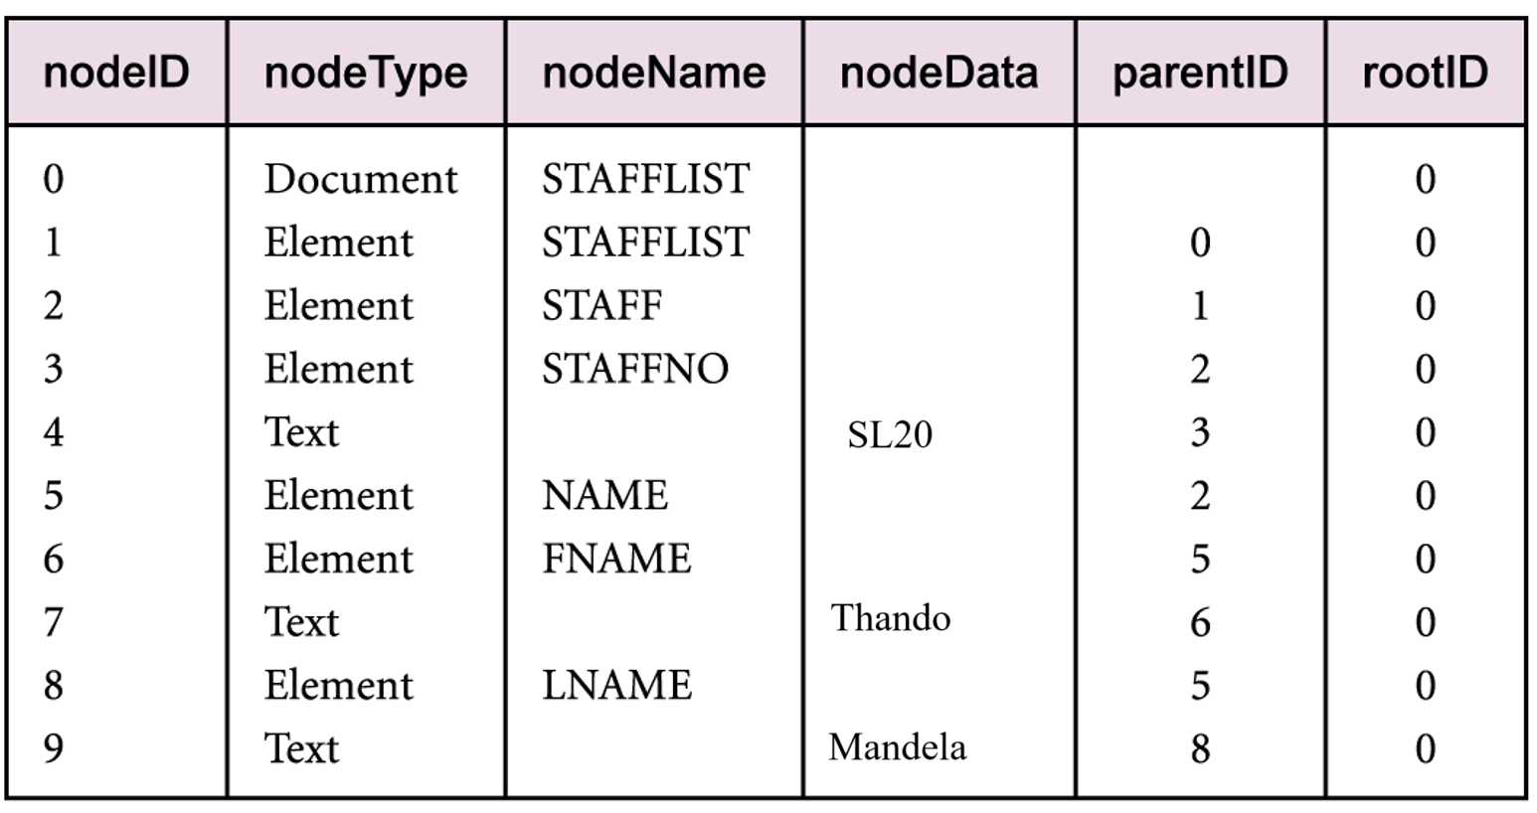
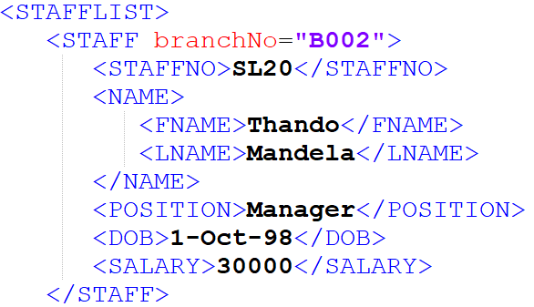
Approach 3: Schema-Independent Representation
e.g.
create a relation (table) from the Document Object Model (DOM)
for the xml document

Slide 7
2. XML and SQL standards
In SQL:2003, SQL:2008 and SQL:2011
Native XML data type: XML
Set of XML/SQL operators for the type
Set of XML/SQL functions
Set of mappings from relational data to XML
© Pearson Education Limited 1995, 2005

Slide 8
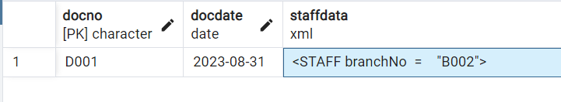
Creating Table using XML data type
CREATE TABLE XMLStaff (
docNo CHAR(4) PRIMARY KEY,
docDate DATE, staffData XML );
INSERT INTO XMLStaff VALUES ('D001',
DATE '2023-08-31',
XML ('<STAFF branchNo = "B002">
<STAFFNO> SL20 </STAFFNO>
<POSITION> Manager </POSITION>
<DOB> 1998-10-01 </DOB>
<SALARY> 30000 </SALARY> </STAFF>') );
SELECT * FROM XMLStaff;
Note: staffdata result is partially displayed in this figure. Double click to see all data
© Pearson Education Limited 1995, 2005

Slide 9
SQL/XML Functions (reading for the student)
XMLFOREST
generates XML value with a list of elements as children of a root item.
XMLCONCAT
concatenates a list of XML values
XMLPARSE
performs a non-validating parse of a character string to produce an XML value
XMLROOT
creates an XML value by modifying the properties of the root item of another XML value
XMLCOMMENT
generates an XML comment
XMLPI
generates an XML processing instruction
XMLSERIALIZE
generates a character or binary string from an XML value
XMLAGG
aggregate function, to generate a forest of elements from a collection of elements

Slide 10
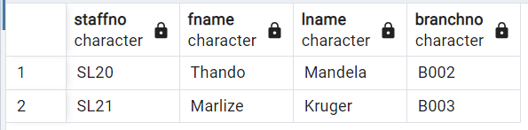
SQL/XML Operators (1)
CREATE TABLE staff (
staffNo CHAR(4), fName CHAR(10),
lName CHAR(10), branchNo CHAR(4) );
INSERT INTO staff VALUES ('SL20', 'Thando', 'Mandela', 'B002');
INSERT INTO staff VALUES ('SL21', 'Marlize', 'Kruger', 'B003’);
SELECT * FROM STAFF;

Slide 11
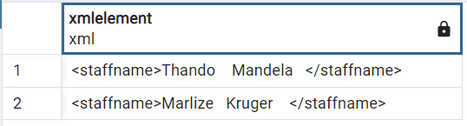
SQL/XML Operators (2)
XMLELEMENT
generates XML value with a single element as a child of its root item.
e.g.
SELECT
xmlelement ( NAME staffname, concat(fName,lName) )
FROM Staff;
© Pearson Education Limited 1995, 2005

Slide 12
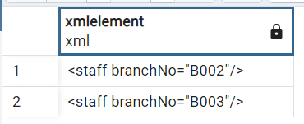
SQL/XML Operators (3)
Element can have zero or more attributes
specified in the XMLATTRIBUTES sub-clause.
e.g.
SELECT xmlelement ( NAME staff,
xmlattributes (branchNo AS "branchNo" ) )
FROM Staff;
© Pearson Education Limited 1995, 2005

Slide 13
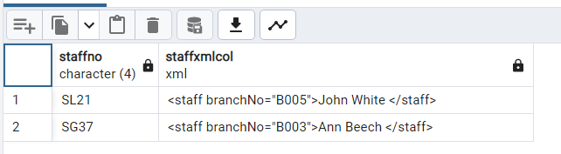
SQL/XML Operators (4)
List all staff as XML elements with name and branch number as an attribute
SELECT staffNo, xmlelement
( NAME staff,
xmlattributes ( branchNo AS "branchNo" ),
concat(fName,lName)
) AS staffXMLCol FROM Staff;
© Pearson Education Limited 1995, 2005

Slide 14
SQL/XML Mapping Functions
SQL/XML
defines functions for mapping from tables to XML documents
mappings produces two types of XML documents:
mapped table data
e.g. PostgreSQL: table_to_xml
XML Schema describing the mapped table data
e.g. PostgreSQL: table_to_xmlschema
© Pearson Education Limited 1995, 2005

Slide 15
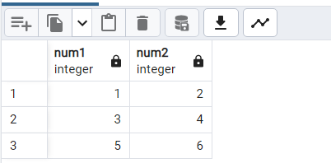
PostgreSQL and XML data (1)
Functions for converting tables to XML
(PostgreSQL 16 documentation )
Queries:
CREATE TABLE numbers( num1 int, num2 int);
INSERT INTO NUMBERS VALUES(1,2);
INSERT INTO NUMBERS VALUES(3,4);
INSERT INTO NUMBERS VALUES(5,6);
SELECT * FROM NUMBERS;

Slide 16
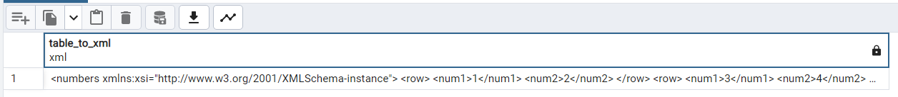
PostgreSQL and XML data (2)
Queries to generate XML from table
SELECT table_to_xml('Numbers', false, false,'');
--OR:
SELECT query_to_xml('SELECT num1, num2 FROM Numbers', false,false, '');
Output (when table_to_xml is used):

Slide 17
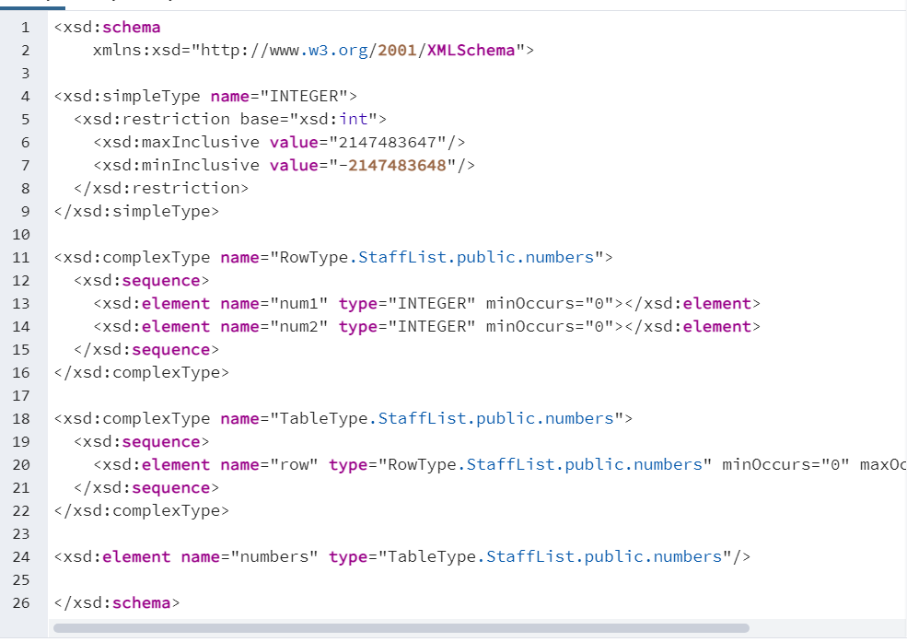
PostgreSQL and XML data (3)
Generate XML schema from table
Query:
SELECT table_to_xmlschema('Numbers', false,false,'');
--OR:
SELECT query_to_xmlschema('SELECT num1, num2
FROM Numbers', false,false,'');
Output when table_to_xmlschema is used (partial listing):

Slide 18
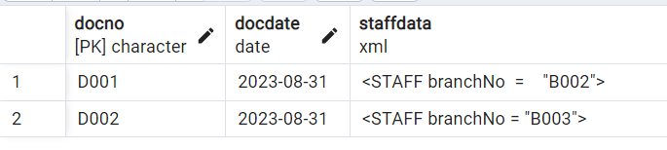
Creating Table using XML Type
CREATE TABLE XMLStaff (
docNo CHAR(4) PRIMARY KEY,
docDate DATE, staffData XML );
INSERT INTO XMLStaff VALUES ('D002', DATE '2023-08-31',
XML('<STAFF branchNo = "B003">
<STAFFNO>SL21</STAFFNO>
<POSITION>Accountant</POSITION>
<DOB>2002-11-02</DOB>
<SALARY>27000</SALARY> </STAFF>') );
SELECT * FROM XMLStaff;
© Pearson Education Limited 1995, 2005

Slide 19
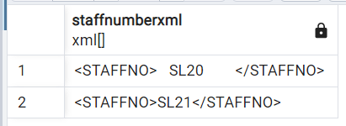
PostgreSQL and XML data (4a)
SQL and XPath queries:
syntax is: xpath( ‘xpath_expression’, colname)
Returns an XML element in curly brackets
SELECT xpath ('/STAFF/STAFFNO',staffData) AS StaffNumberXML
FROM XMLStaff;
Results:

Slide 20
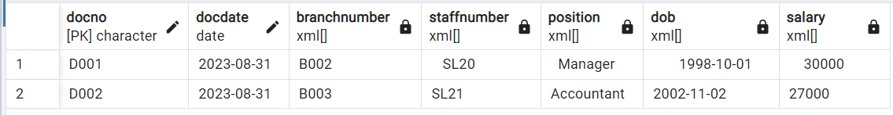
PostgreSQL and XML data (4b)
SQL and XPath queries:
syntax is: xpath( ‘xpath-expression’, colname)
***Use text() function to remove tags
SELECT docNo, docDate,
xpath ('/STAFF/@branchNo',staffData) AS BranchNumber,
xpath ('/STAFF/STAFFNO/text()',staffData) AS StaffNumber,
xpath ('/STAFF/POSITION/text()',staffData) AS Position,
xpath ('/STAFF/DOB/text()',staffData) AS DOB,
xpath ('/STAFF/SALARY/text()',staffData) AS Salary
FROM XMLStaff;
Results:

Slide 21
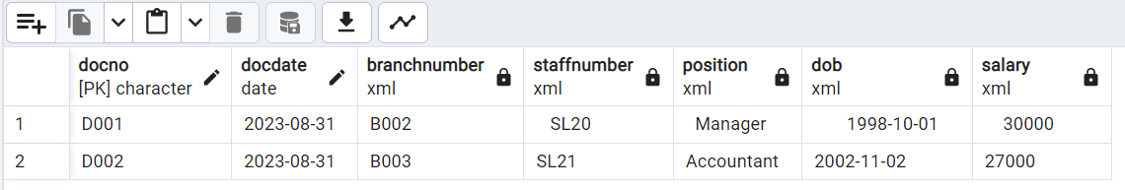
PostgreSQL and XML data (5)
SQL, XPath queries & unnest function:
. The unnest function is converting an array into a table-like structure; we can also generate a table structure of an array using unnest function in PostgreSQL
SELECT docNo, docDate,
unnest(xpath ('/STAFF/@branchNo',staffData) ) AS BranchNumber,
unnest(xpath ('/STAFF/STAFFNO/text()',staffData)) AS StaffNumber,
unnest(xpath ('/STAFF/POSITION/text()',staffData) ) AS Position,
unnest(xpath ('/STAFF/DOB/text()',staffData) ) AS DOB,
unnest(xpath ('/STAFF/SALARY/text()',staffData) ) AS Salary
FROM XMLStaff;
Results:

Slide 22
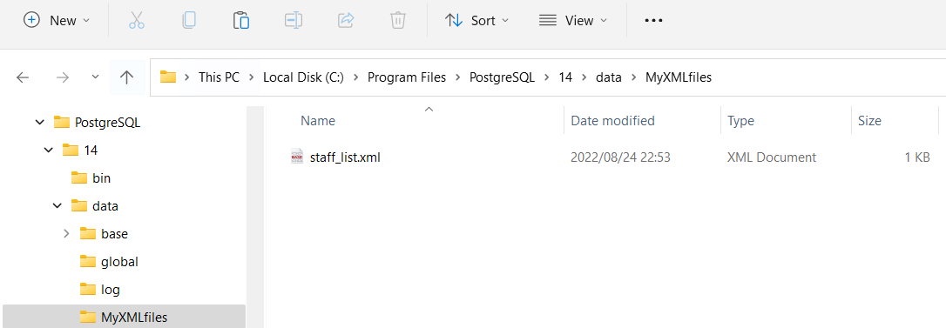
Importing XML data into PostgreSQL DB (1)
the current working directory (cwd) for pgAdmin4 is
C:\Program Files\PostgreSQL\16\data
So, create a folder under ‘data’ and store your XML files here, e.g. folder ‘MyXMLfiles’

Slide 23
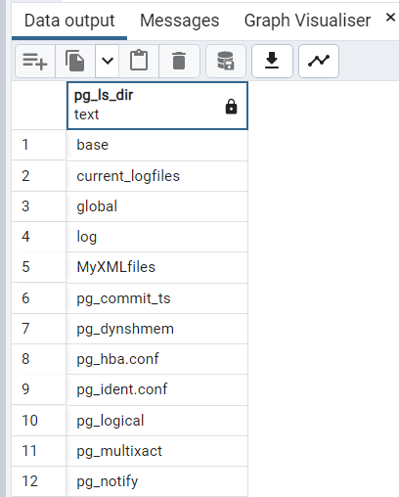
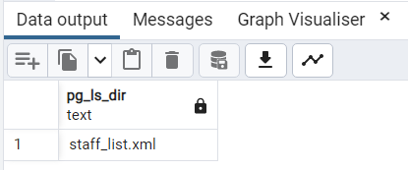
Importing XML data into PostgreSQL DB (2)
e.g. query to list the files/folders under the cwd (data)
SELECT pg_ls_dir('.');
query to list files/folders in the cwd sub-folder MyXML files:
SELECT pg_ls_dir('./MyXMLfiles');

Slide 24
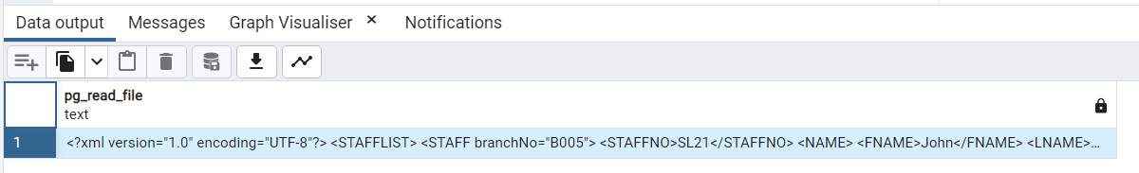
Importing XML data into PostgreSQL DB (3)
Query to read contents of a file & return contents as text type
SELECT pg_read_file('./MyXMLfiles/staff_list.xml');

Slide 25
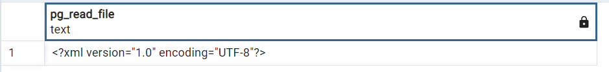
Importing XML data into PostgreSQL DB (4)
Query to read & present file contents as xml type
SELECT CAST(pg_read_file('./MyXMLfiles/staff_list.xml')
AS xml);

Slide 26
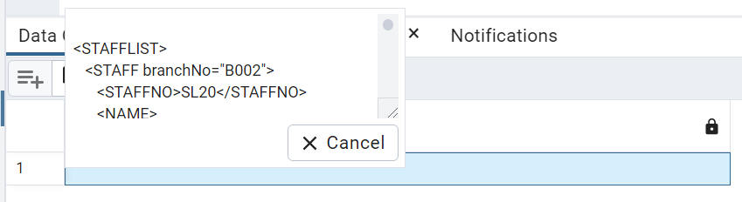
Importing XML data into PostgreSQL DB (5)
Create a temp xml table & load xml file contents into this table
SELECT (CAST( pg_read_file
( './MyXMLfiles/staff_list.xml')
AS xml) )
AS xmldata
INTO NewXMLtable;
then:
SELECT * FROM NewXMLtable;

Slide 27
Importing XML data into PostgreSQL DB (6)
Use xpath to create an array of <STAFF> …</STAFF>
elements.
SELECT
xpath ('//STAFF',xmldata)
AS XMLcol
FROM NewXMLtable;
HOMEWORK:
Write a plpgsql function to store array elements into a table, with one element per row
Query result:
{ " <STAFF branchNo=\"B002\">
<STAFFNO>SL20</STAFFNO>
<NAME> <FNAME>Thando</FNAME>
<LNAME>Mndela</LNAME>
</NAME>
<POSITION>Manager</POSITION>
<DOB>1998-10-01</DOB>
<SALARY>30000</SALARY>
</STAFF> ",
" <STAFF branchNo=\"B003\">
<STAFFNO>SL21</STAFFNO>
<NAM (...) "

